Slide 1

Expense Tracker
An Easy Way to Manage your Money....

Slide 2

Guided By:
​
Dr. Bela Shrimali
CE-Department
LDRP-ITR
Created By:
Bhadaja Pavankumar Vithaldas​
Amin Sanket Kalpeshbhai​
Shah Raj Rakeshkumar​

Slide 3
Outline of Presentation:
System Definition
Technologies
Project Structure
Continuous Deployment
Functional Requirements
Screen Design
Future Plans
Live Implementation
Loc

Slide 4

Expense Tracker
What?
Why?

Slide 5





Technologies
NERF Stack

Slide 6

Functional Requirements:
• User can access site and use functionality without registration
• After creating transaction form choices should not be changed.
• User can share their tracker board with other users.
• User can see visual output of information he/she has given.
• User should be able to change different graphs to visualize their data. • User should be able to make their custom type and categories

Slide 7
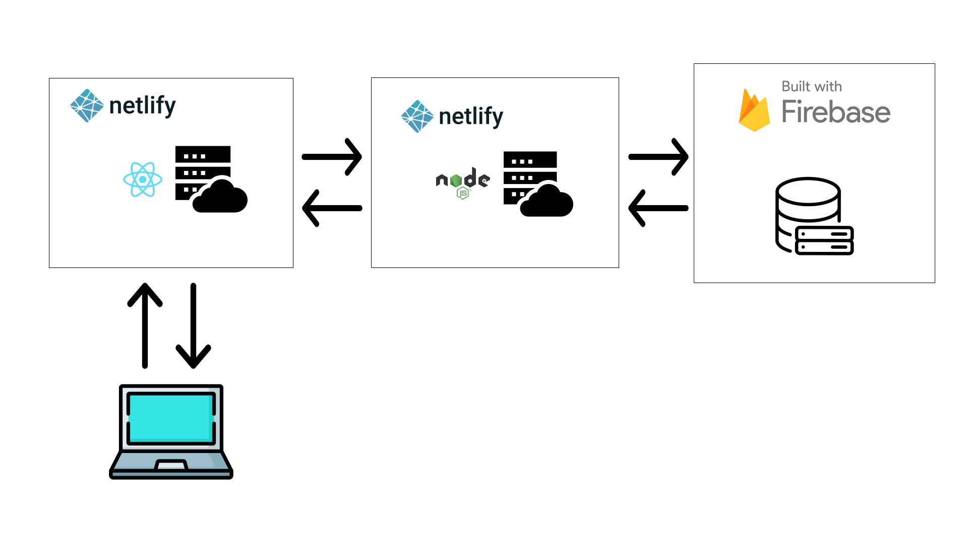

Project Structure:

Slide 8
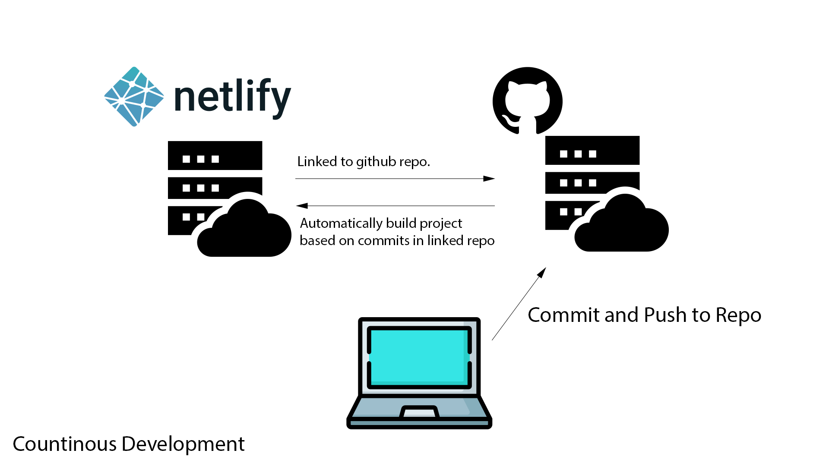
Continuous Deployment:

Slide 9
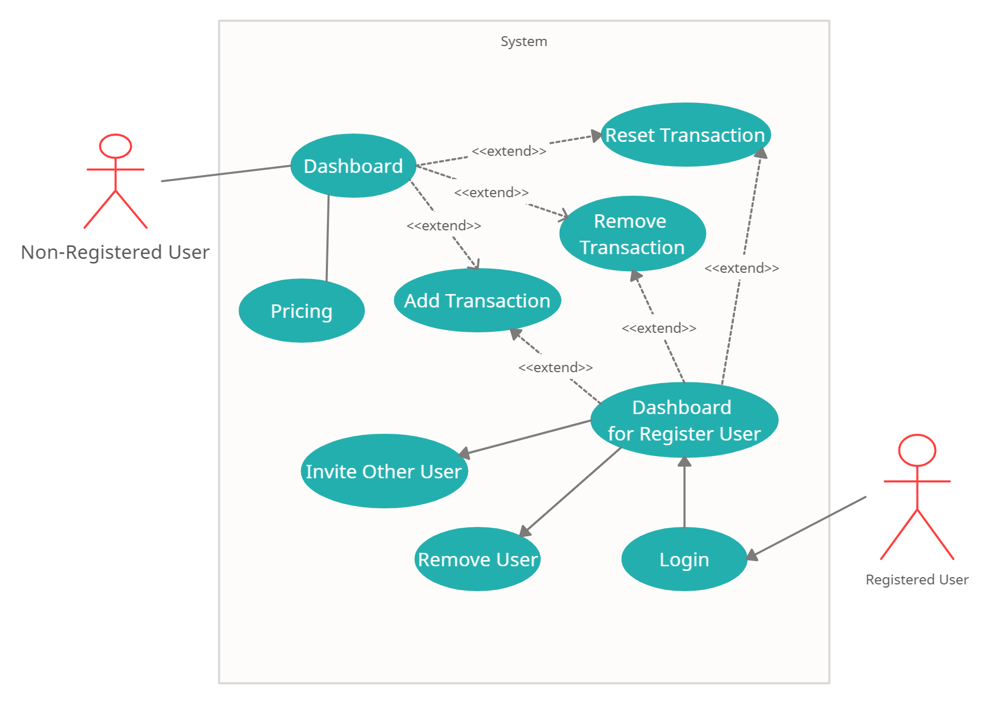
Use case Diagram:

Slide 10
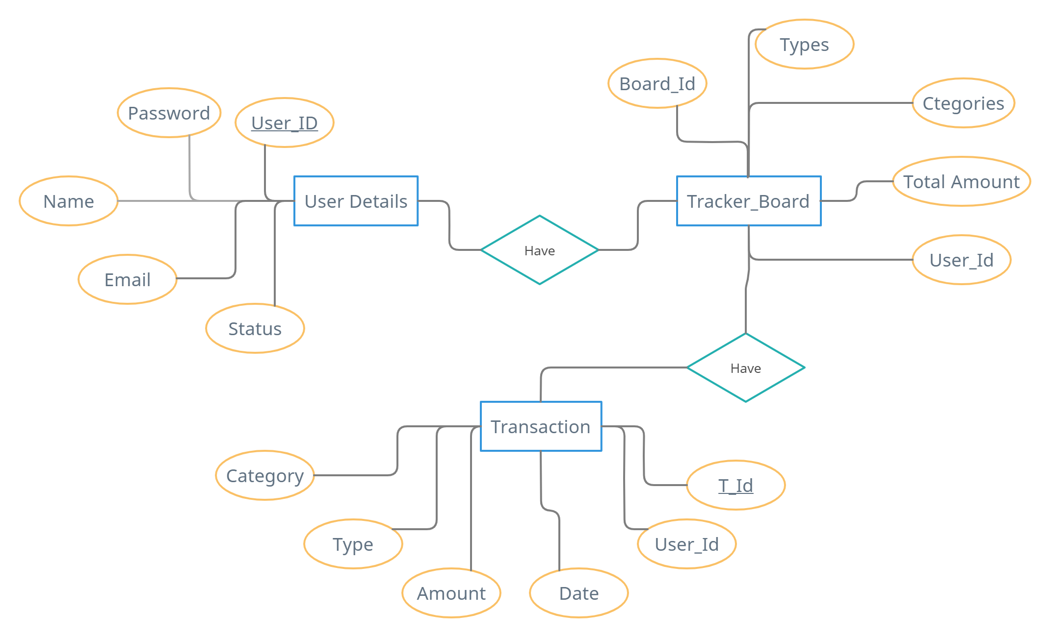
ER Diagram:

Slide 11
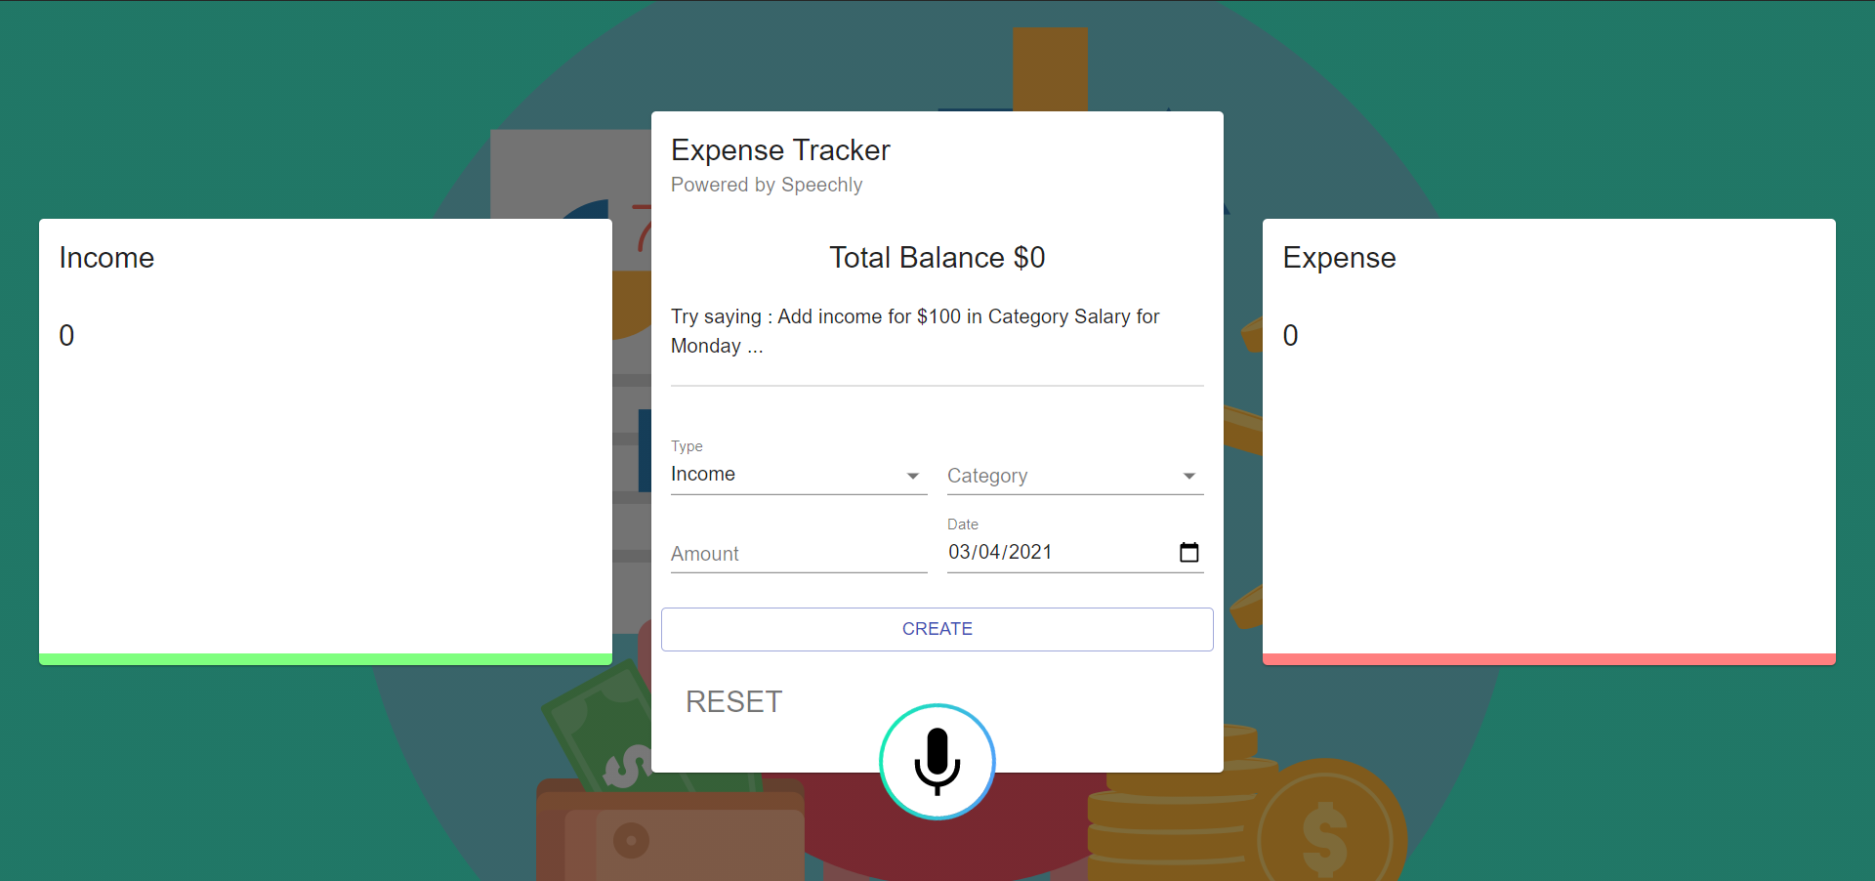
Naïve View

Slide 12
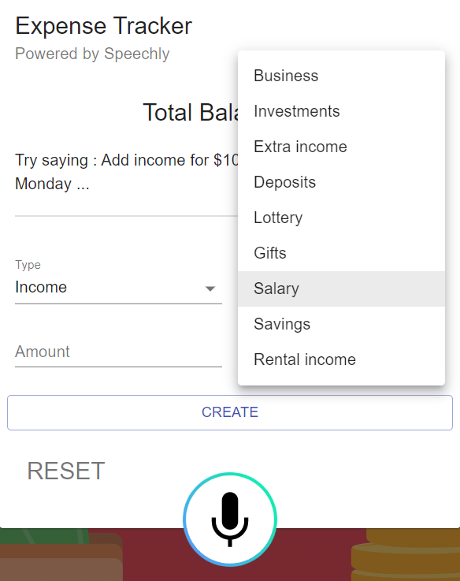
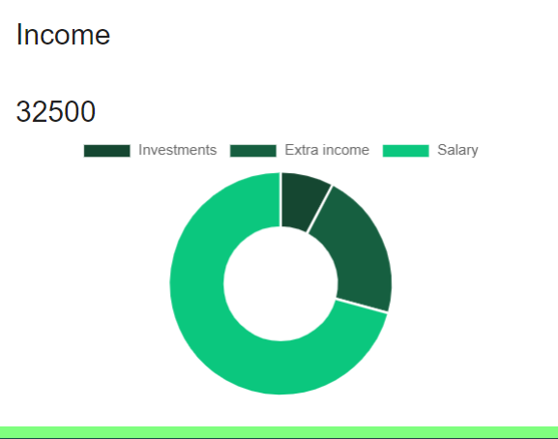
Income Panel:

Slide 13
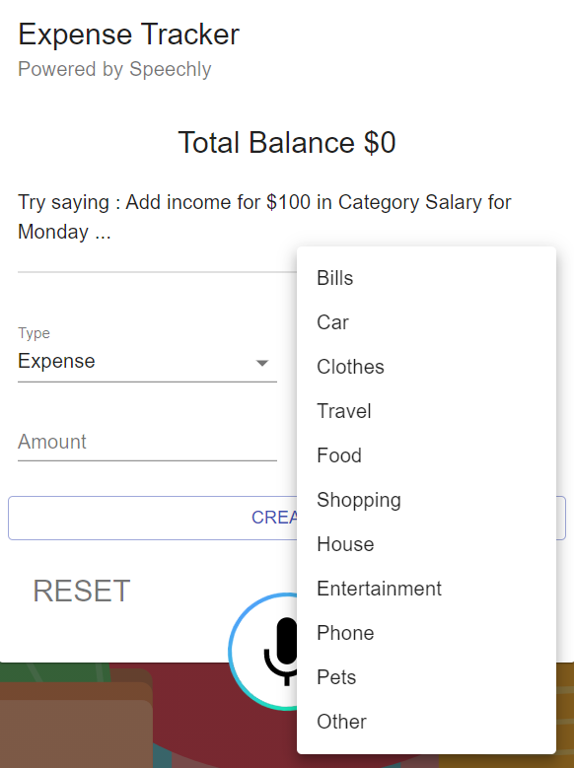
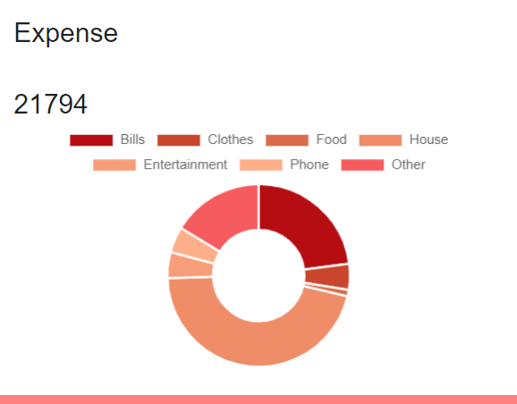
Expense Panel:

Slide 14
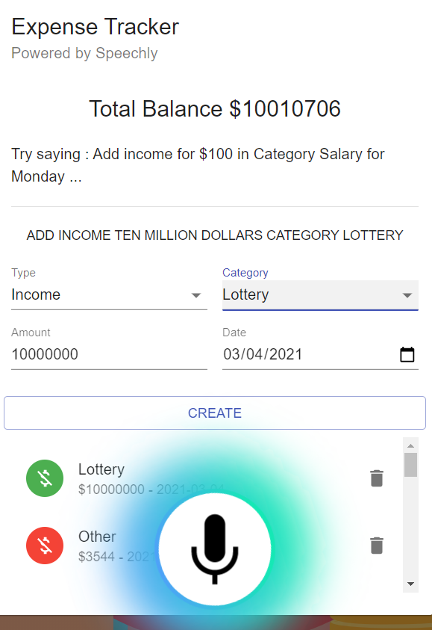
Voice Command Inputs

Slide 15
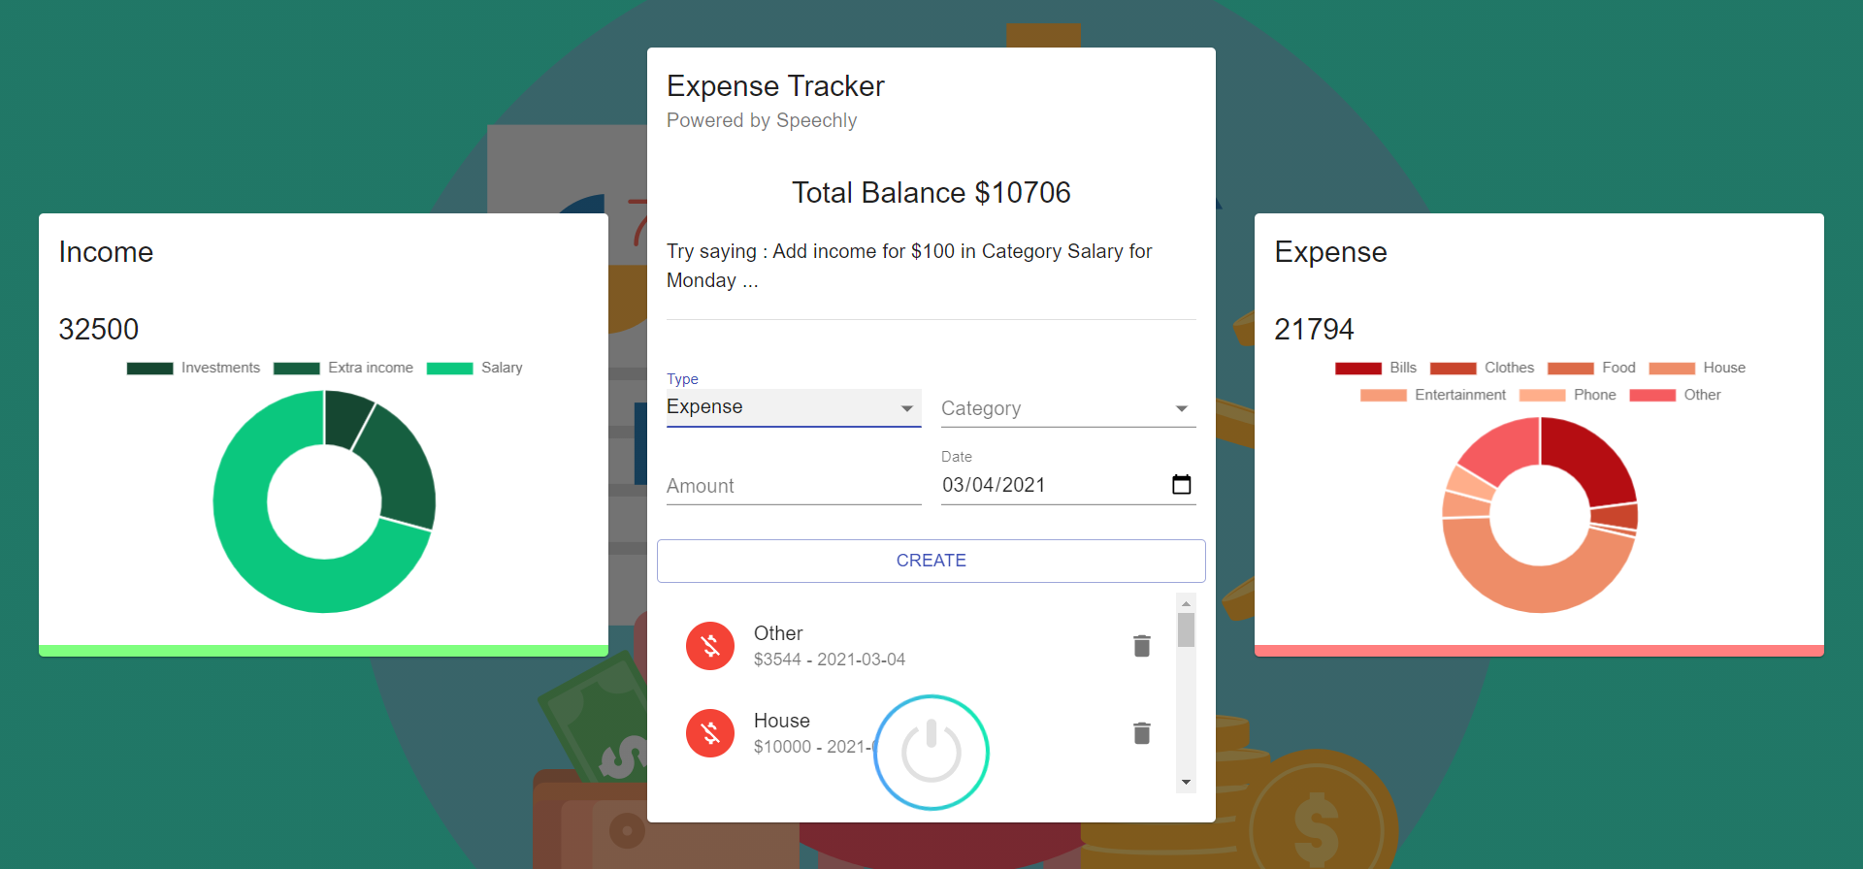
Evolved View:

Slide 16
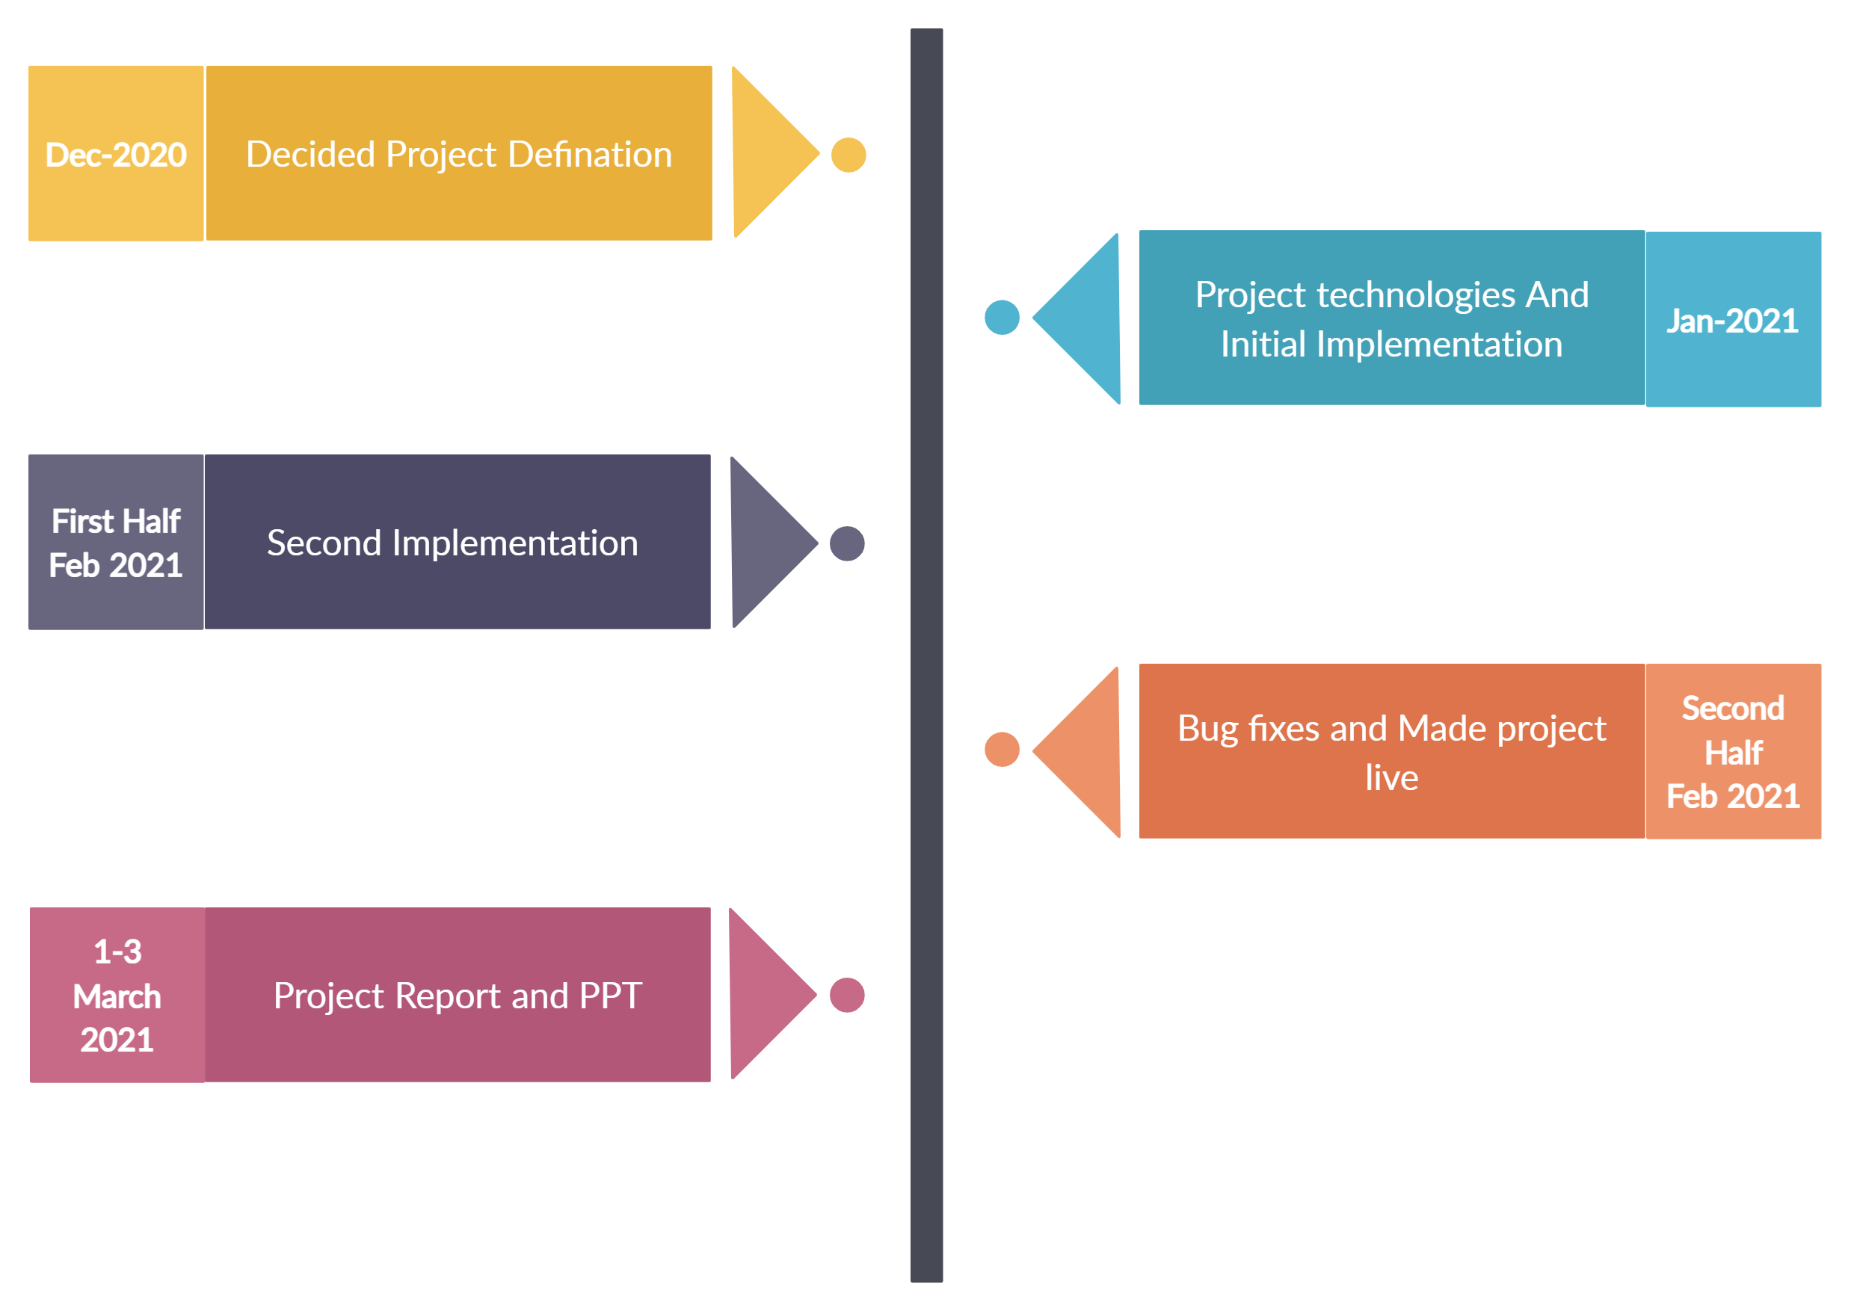
Timeline Chart:

Slide 17
Future Plans:
Multi User Support
Customization in Type & Categories
Different Graph Functionality

Slide 18
References:
Material UI : https://material-ui.com/
ChartJS2 : https://www.chartjs.org/docs/latest/
React Hooks : https://reactjs.org/docs/hooks-reference.html

Slide 19

Thank You

